Slide 1
Recursive Algorithms
경북대학교 컴퓨터공학과
유관우

Slide 2
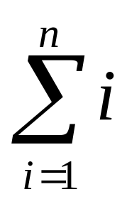
S(n) =
Iteration
S(n) = 1 + 2 + ··· + n
int S1 (int n) {
int s = 0;
for (i=1; i<=n; i++)
s = s + i;
return s;
}
Main : sum = S1(10);

Slide 3
S(n) =
2. Recursion
0 if n <= 0
S(n-1) + n if n > 0
int S2 (int n) {
if (n <= 0) return 0;
return ( S2(n-1) + n);
}
Main : sum = S2(10);
{
S(n) =

Slide 4
Time Complexity
Iteration : O(n)
Recursion
1 if n <= 0
T(n-1) + 1 if n > 0
{
T(n) =

Slide 5
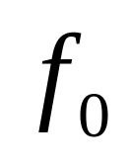
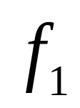
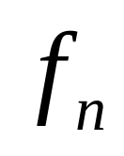
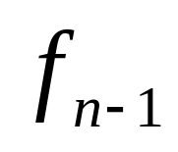
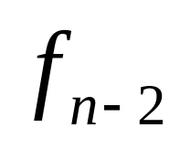
Fibonacci Sequence
= 0,
= 1
(
=
+
int F1 (int n) {
if (n <= 1) return n;
return (F1(n-1) + F1(n-2));
}
Main : Fib = F1(100);

Slide 6
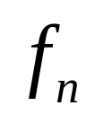
Fibonacci Sequence
= 0,
= 1
(
=
+
Iteration
int F2 (int n) {
int F[n+1]; F[0] = 0; F[1] = 1;
for (i = 2; i <=n; i++)
F[i] = F[i-1] + F[i-2];
return (F[n]); }

Slide 7
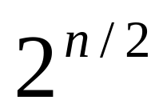
Time Complexity
Iteration : O(n)
Recursion
1 if n <= 0
T(n-1) + T(n-2) + 1 if n > 0
T(n) >
{
T(n) =

Slide 8
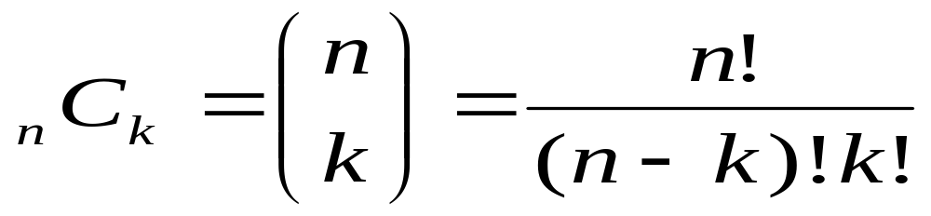
{
1 if n == 0
(n-1)! * n if n > 0
n! =
int Fact (int n) {
if (n <= 0) return 1;
return (Fact(n - 1) * n);
}

Slide 9
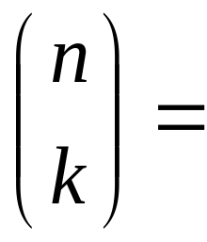
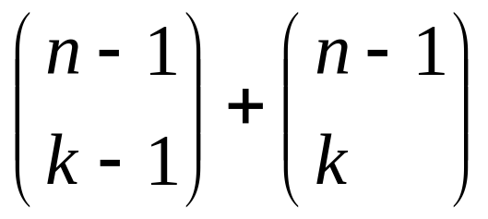
Recursive Definition?
{
1 if n == k or k == 0
otherwise
int Comb (int n, k) {
if (n == k || k == 0) return 1;
return (Comb(n-1, k-1) + Comb(n-1, k));
}

Slide 10

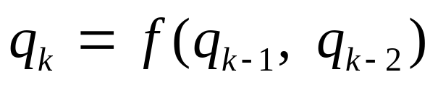


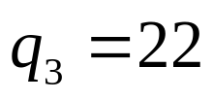

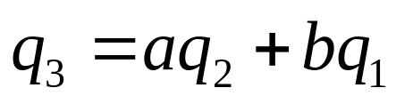

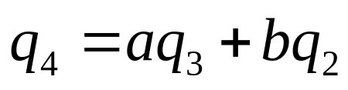
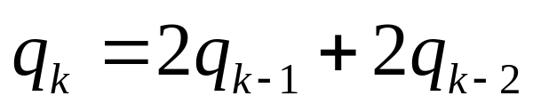
연립방정식 :
2. Recursive Property :

Slide 11
Tower of Hanoi
1
2
3

Slide 12
Tower of Hanoi
1
2
3

Slide 13
Tower of Hanoi
void T_H (int A, B, C, n) {
if ( n<=0 ) return;
T_H (A, C, B, n-1);
print (“Move disk”, n, “from”, A, “to”, C);
T_H (B, A, C, n-1);
}
T(n) =
{
1 if n <= 0
T(n - 1) + 1 + T(n - 1) if n > 0

Slide 14
T(n) =
T(n) = 2T(n - 1) + 1
= 2(2T(n - 2) + 1) + 1
= 2²T(n – 2) + 2 + 1
= ···
= 2^{n}T(n - n) + 2^{n-1} + ··· + 1
= 2^{n} + 2^{n-1} + ··· + 1
= 2^{n+1} - 1
{
1 if n <= 0
2T(n-1) + 1 if n > 0

Slide 15
Coin Change Problem
우리나라 동전 시스템
968원?
500
100
10
50
5
1
500
100
10
50
5
1
1개
4개
1개
1개
1개
3개
G r e e d y 최적방법

Slide 16
Coin Change Problem
이상한 나라
12원?
Greedy (3개)
최적 :
8
6
2
1
8
X
2
2
6
6
Dynamic Programming

Slide 17
Recurrence Relation
N[k] : #min coins for k wons
0 if k == 0
N[k] = ∞ if k < 0
min if k > 0
{
{
}
N[k - 1],
N[k - 2],
N[k - 6],
N[k - 8]
+ 1

Slide 18
int Coin1(int n) {
if (n == 0) return 0;
if (n < 0) return 999999;
return (min (Coin1(n – 1),
Coin1(n – 2),
Coin1(n – 6),
Coin1(n – 8)) +1);
}

Slide 19
int Coin2(int n) {
int N[n+1];
N[0] = 0;
for (int i = 1; i <= n; i++) {
M = N[i-1];
if (i >= 2) M = min(M, N[i-2]);
if (i >= 6) M = min(M, N[i-6]);
if (i >= 8) M = min(M, N[i-8]);
N[i] = M + 1;}
return N[n];
}

Slide 20
a | b | b
0 | 0 | 0
0 | 0 | 1
0 | 1 | 0
0 | 1 | 1
1 | 0 | 0
1 | 0 | 1
1 | 1 | 0
1 | 1 | 1
n Boolean variables
0 0 0 ······ 0
·
·
·
1 1 1 ······ 1
2^{n}
Iteration ?
Recursion : Easy
Main : boolean a[100];
Comb1 (a, 0, 50);

Slide 21
0
n - 1
a :
·
·
· · ·
0
n - 1
(1) a
0
· · ·
모든 가능한 경우 출력 : 2^{n-1}
0
n - 1
(2)
1
· · ·
모든 가능한 경우 출력 : 2^{n-1}

Slide 22
void Comb1 (boolean *a, int k, n) {
if (k >= n) { print(a[0... n-1]);
return; }
a[k] = 0; Comb1(a, k + 1, n);
a[k] = 1; Comb1(a, k + 1, n);
}
Time Complexity :
T(n - k) =
T(n) = O(n2^{k})
{
n if k >= n
2T(n-k-1) + 2 if k < n

Slide 23
a | b | b
0 | 0 | 0
1 | 0 | 0
0 | 1 | 0
1 | 1 | 0
0 | 0 | 1
1 | 0 | 1
0 | 1 | 1
1 | 1 | 1
n Boolean variables
0 0 0 ······ 0
·
·
·
1 1 1 ······ 1
2^{n}
Recursion ?

Slide 24
void Comb2 (boolean *a, int k, n) {
if (k < 0) { print(a[0... n-1]); return; }
a[k] = 0; Comb2(a, k - 1, n);
a[k] = 1; Comb2(a, k - 1, n);
}
Main : Comb2 (a, n-1, n)

Slide 25
Orders. aabb aabb
abab
abba
baab
baba
bbaa

Slide 26
Void perm(char* a, int k, int n){
If(k >= n) …
sort(a, k, n);
perm(a, k+1, n); sort(a, k+1, n);
while( there exists an m s.t. m>k &&
a[m]>a[k]) {
exchange a[k] & a[m];
perm(a, k+1, n); sort(a, k+1,n);
}
}

